Slide 1

A DATA DRIVEN ANALYSIS AND OPTIMIZATION
APPROACH FOR ENHANCING ORGANIZATIONS
PERFORMANCE
PREDICTING EMPLOYEE PROMOTION:
SHIVANGI GUPTA
ASSISTANT PROFESSOR
PG DIPLOMA IN DATA SCIENCE
AASHIMA BANGIA

Slide 2


CONTENT
Introduction
Defining the question
Collecting the dataset
EDA
Model selection
Prediction
Key Findings
Conclusion

Slide 3

INTRODUCTION
There are many advantages that comes with promotion in the workplace. It comes with increase in prestige, respect and wages/salary. Promotion in a business environment also comes with increase freedom and agency. It is because of this that many employees at different levels in an organization tries to climb the corporate ladder in order to enjoy the various advantages that comes with it.
This project is important for both employers looking to start training in arears to promotion of employees. It is also important to employees to determine their strength and weaknesses, opportunities and threats, as well as, key factors to work on in order to get promoted. Although this is a case study of a given firm, the findings of this study can be applied to various firms.

Slide 4

DEFINING THE PROBLEM
What are the most important features and the influence these features have in predicting employee promotion with a particular row of data?
Which features are the strongest in predicting employee promotion?

Slide 5

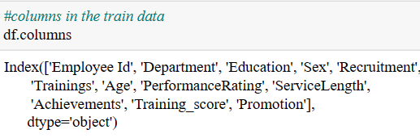
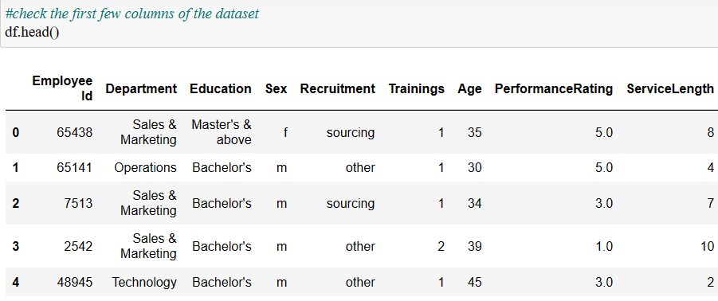
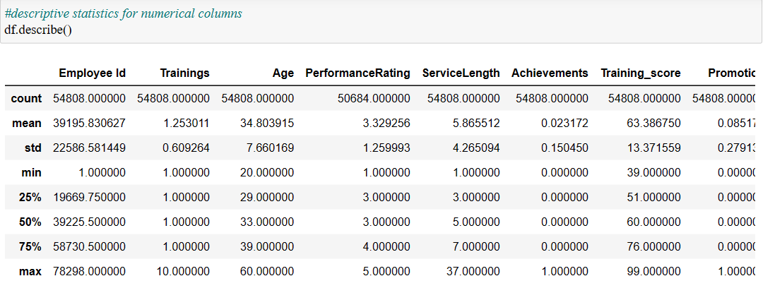
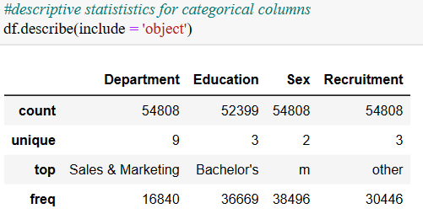
COLLECTING THE DATA
Following Data is collected from the IEEE Website.
It contains the 54808 records with 13 attributes.
A large MNC have 9 broad verticals across the organization. One of the problem is identifying the right people for promotion (only for manager position and below) and prepare them in time.
The final promotions are only announced after the evaluation and this leads to delay in transition to new roles. Hence, company needs help in identifying the eligible candidates at a particular checkpoint so that they can expedite the entire promotion cycle.

Slide 6

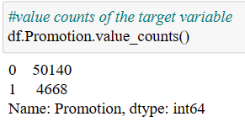
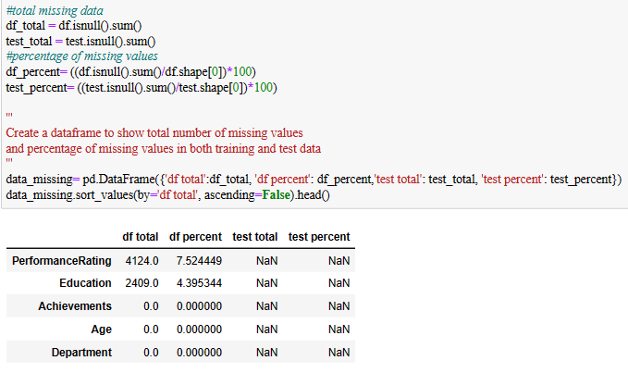
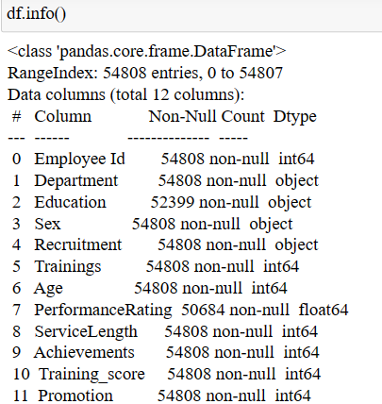
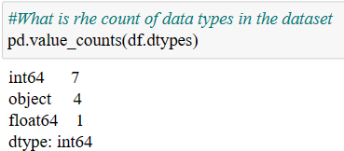
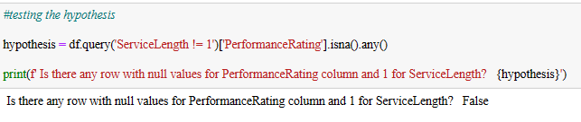
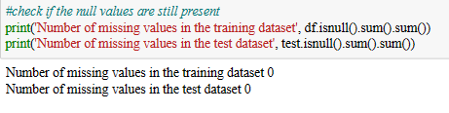

Slide 7

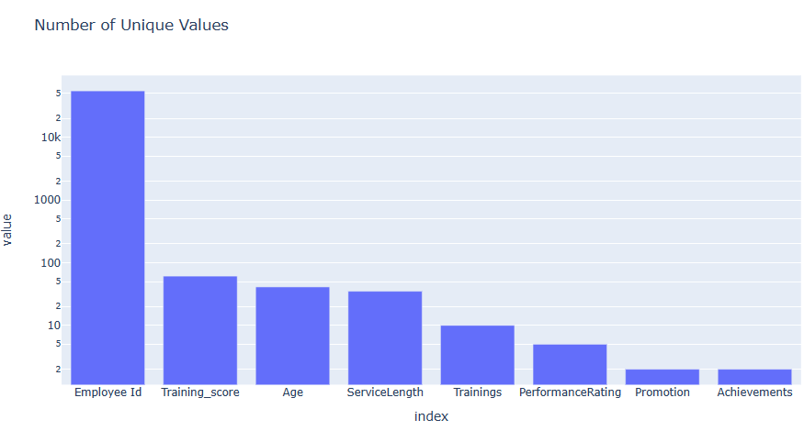
EXPLORATORY DATA ANALYSIS

Slide 8

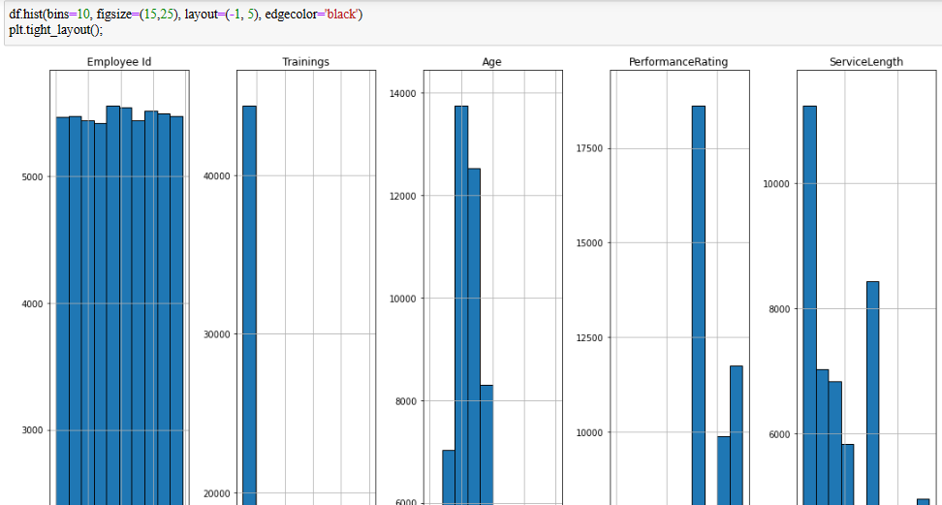
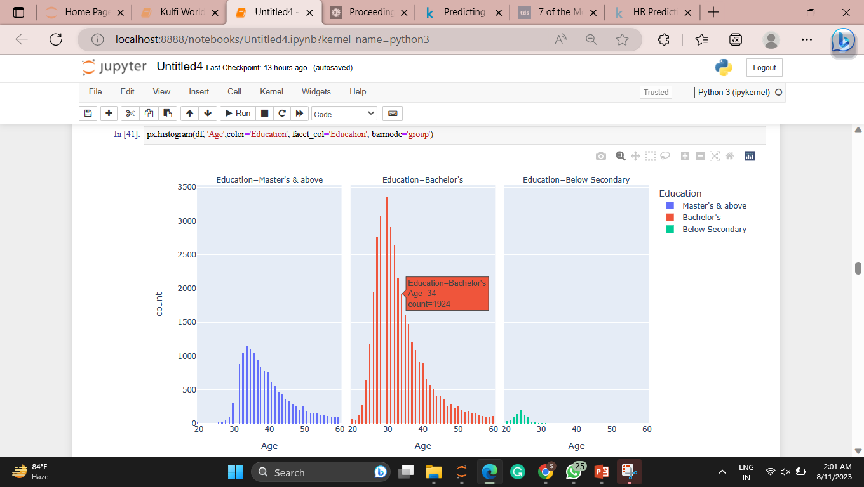
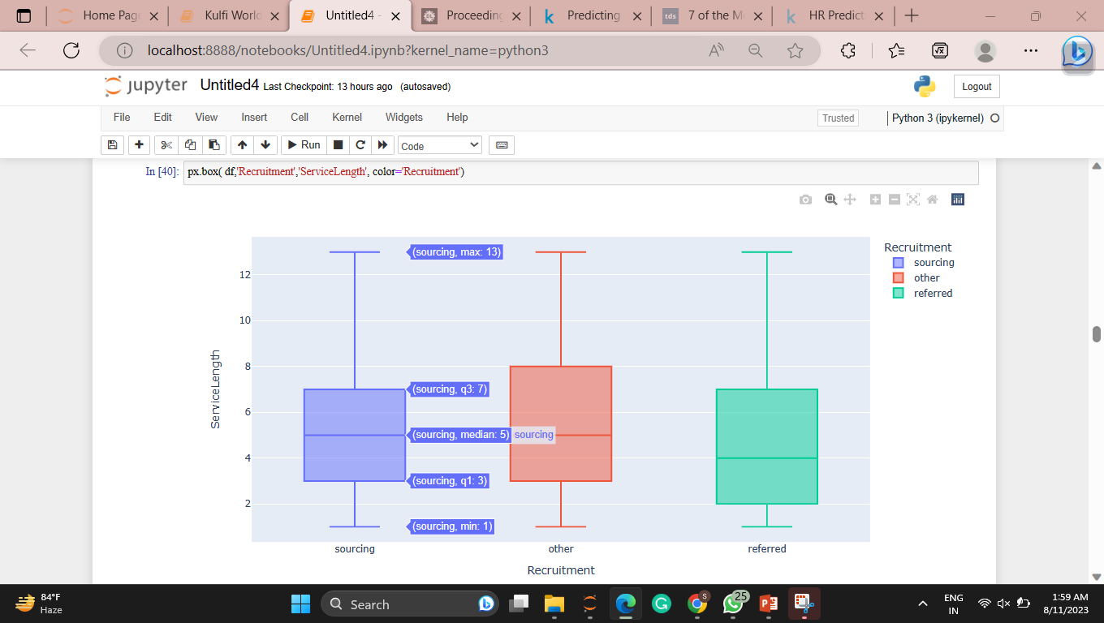
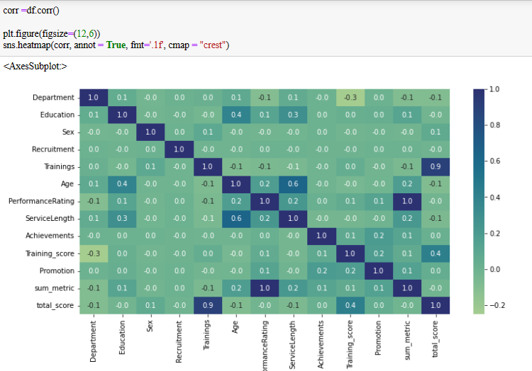
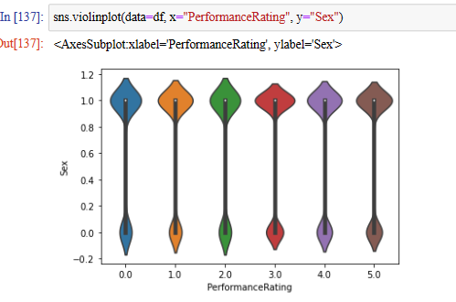
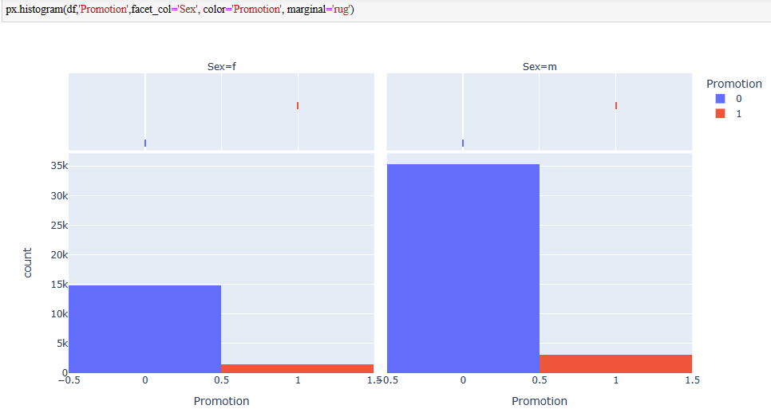

Slide 9
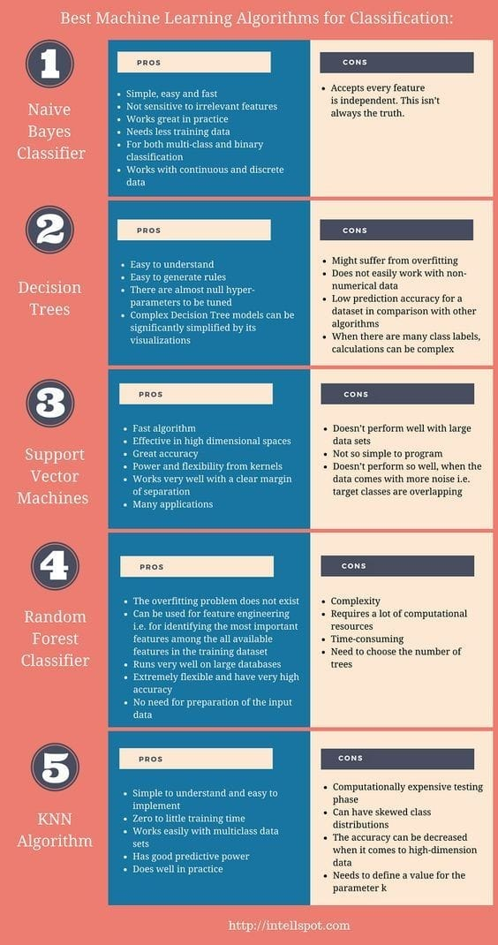

MACHINE LEARNING
MODELS

Slide 10

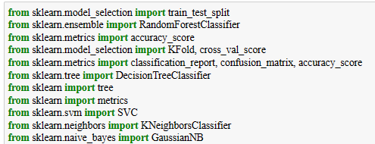
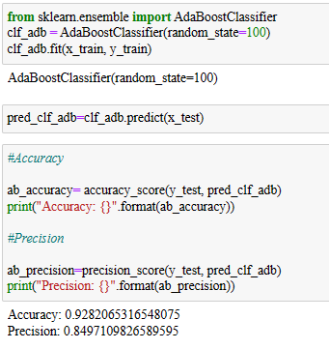
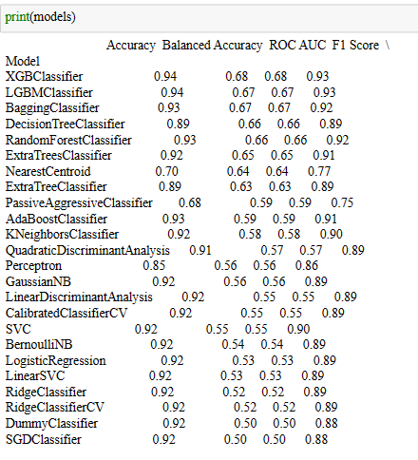
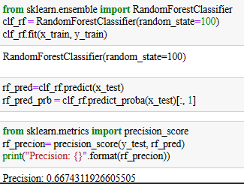
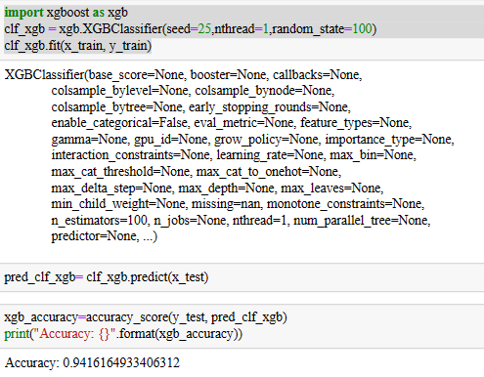
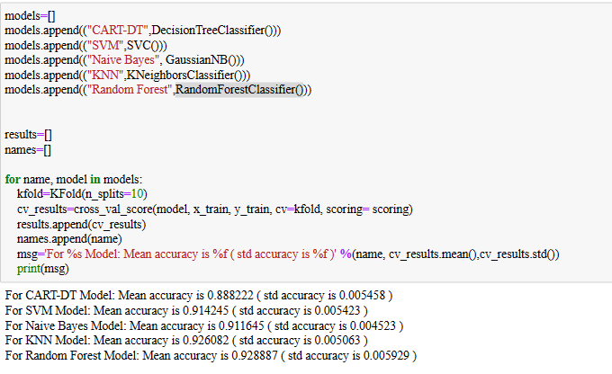
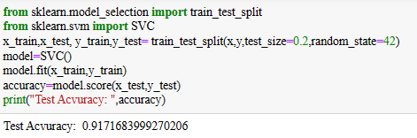
MODEL SELECTION

Slide 11

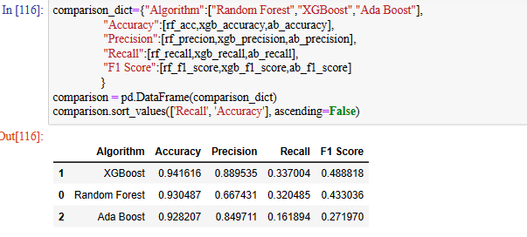
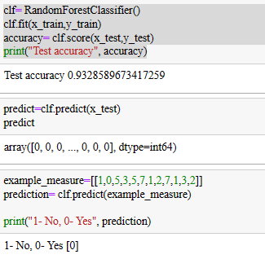
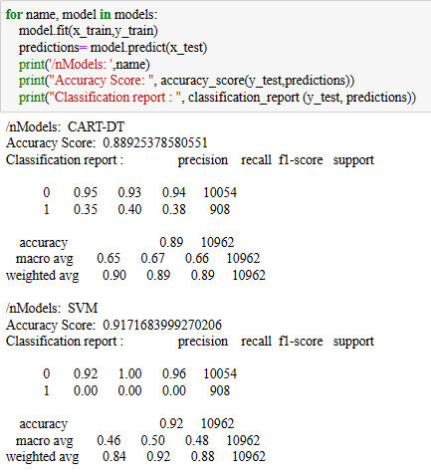
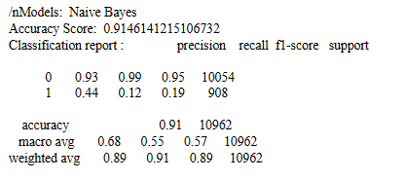
PREDICTION

Slide 12
KEY FINDINGS
What are the most important features and the influence these features have in predicting employee promotion with a particular row of data?
To answer this, we use the force plot and the waterfall plot. For the first row of the sample, the most important features were department which increased predicted probability by 0.42. This was followed by Training score which affected the predicted probability by 0.14. The third most important features were sum_metric and Service Length which has a negative SHAP value of 0.05. That is, if this particular sample wants to improve the probability of being promoted, effort should be made to switch department, increase preparation for training test and increase visibility.

Slide 13
2. Which features are the strongest in predicting employee promotion?
To answer this, we use the global bar plot.
The top 5 important features in predicting employee promotion are:
Training_score, department, total_score, age, and sum_metric.
They contribute to predicting employee promotion in that order.

Slide 14
CONCLUSION
The analysis covers from data cleaning to exploration to model training and evaluation before going to the most important part necessary for answering the questions introduced at the beginning, model explain ability/interpretation. The result reveled that avg_training_score, department, total score, age and sum metric has the highest impact on predicting employee promotion. The result also showed that the effect of the prediction varies with Sex.

Slide 15

THANKYOU

